Slide 1
APRS for Emergencies
Amateur Packet Reporting System
Scott N7SS

Slide 2
APRS Use
Originally intended for events
Provides basic location and message handling
Can communicate between base, mobile and portable stations
Allows assets to be plotted on map whether moving or fixed in near real-time
Simple deployment
Notes:
Very simple implementation
There is Base (Radio/TNC), Mobile (D700) and Portable (D7) capability
Bob Bruninga is disappointed at the penetration of APRS radios (Kenwood) and has developed a broader solution with APRStt

Slide 3
What is APRS?
Ad-hoc, connectionless network able to relay position reports and messages
No routing information is required
Packet delivery is not guaranteed
Packets contain position, status or short messages
Many stations can automatically digipeat
IGates (gateways) make data available to the world
APRS-IS server aggregates data from multiple sources and makes it available
Notes:
Invented by Bob Bruninga
Similar hardware requirements to packet radio but easier to implement
Basic capabilities provide position reports and short messages
IGates extend APRS functionality incredibly

Slide 4
APRS Basics
Ad Hoc, Unconnected Network
144.390MHz 1200 baud
144.350 and 440.800MHz 9600 baud
10.1476 MHz USB*
Digipeaters repeat transmissions
Mobile path is WIDE1-1,WIDE2-1
Fixed-station path WIDE2-2
IGates take gateway RF signals to the Internet
No IGates currently in many counties
APRS-IS server is central Internet server
Notes:
Ad Hoc, Unconnected means everyone just blasts information into the ether and hopes someone useful hears it. There is no confirmation in the protocol.
There is an entire discussion online about the frequency vs tone relationship on HF depending on hardware and software used at http://wa8lmf.net/APRS_PSK63/

Slide 5
APRS Stations
Mobiles/trackers with frequent updates
Base stations/digipeaters/IGates
Weather stations
Boats/vessels (via AIS)
Automatic Identification System is marine version of APRS on channels 87B/88B
Winlink/IRLP/Echolink/DSTAR nodes
Other fixed objects can be beaconed
Hamwan nodes, local repeaters, etc.
Notes:
Look at all the different types of nodes that appear on APRS.fi

Slide 6
View APRS Status Online
APRS.fi
Uses Google Maps and integrates all types of APRS and non-APRS sources with tracks
www.FindU.com
Supports a large collection of custom queries
Individual user tracks, weather graphs, emergency messages, regular messages, raw position data, locate Winlink nodes, etc.

Slide 7
APRS.fi

Slide 8
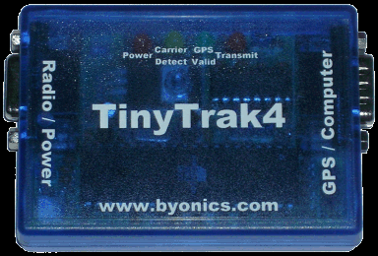
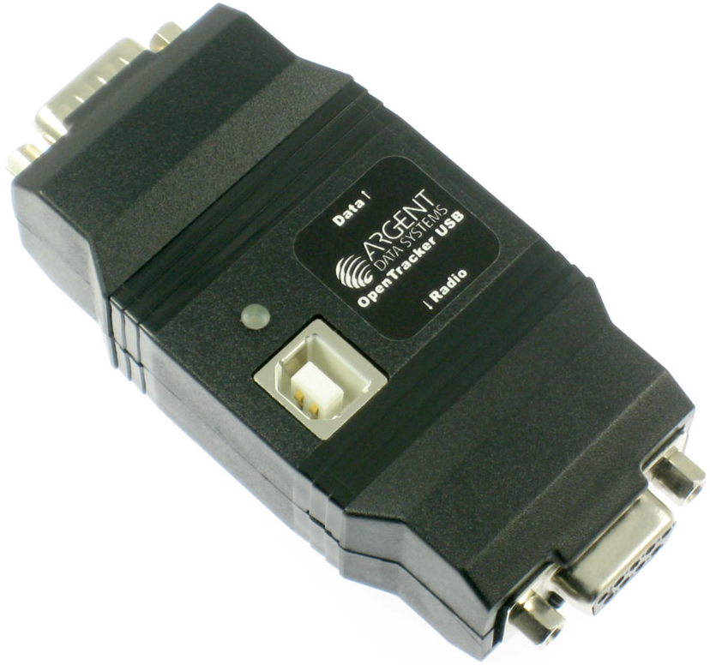
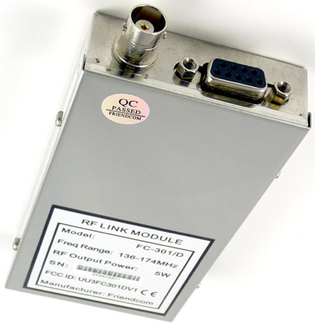
APRS Trackers
Byonics Micro-Trak AIO (All In One)
10 watts, AA batteries, Pelican case, $260
Argent Data Tracker3 model T3-301
5 watts with data port, $229
Sainsonic AP-510
1 watt, Bluetooth, $120
Byonics TinyTrack 3/4
Add APRS to radio, w/GPS, $130
Argent Data OpenTracker USB
Add APRS to existing radio, no GPS, $45
Notes:
Technically, APRS trackers are devices that just beacon APRS positions. That definition is often expanded to include devices that can also receive when connected to a PC. Being able to receive also helps avoid packet collisions even if not connected to a PC. Some of these are fully integrated with radios and others are just the TNC and software to allow connecting to an existing radio and may or may not include a GPS which is generally necessary for tracker support.

Slide 9
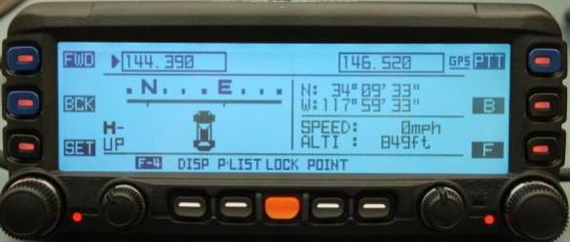
Integrated APRS Trackers
Yaesu VX-8 family, FTM-350, FT-1DR, FT-2DR, FTM-100DR, FTM-400DR
APRS software built into radio
No access to TNC in radio
Notes:
Yaesu advertises its APRS functionality which is crippled by the fact that there is no access to the data or TNC with a PC or other device. This means received units cannot be placed on an actual map, tracks can’t be created, real keyboards can’t be used to send messages, etc. I would argue this places them in the tracker category.

Slide 10
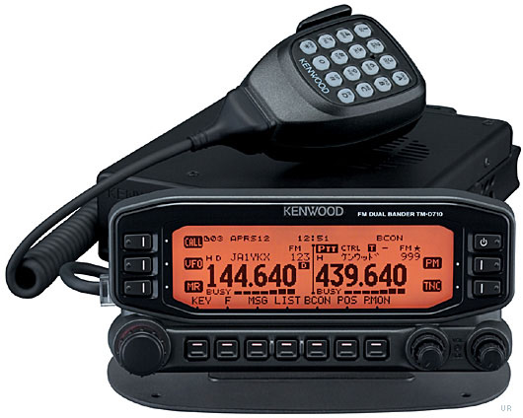
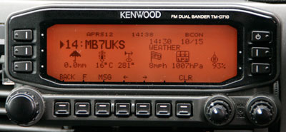
Real Integrated APRS
Kenwood TH-D7AG, TM-D700
Integrated software with access to TNC
TNC has small buffer so only supports APRS
Kenwood TH-D72/D74, TM-D710G
Includes integrated GPS and real TNC
TH-D72 and TH-D74 have USB port
Mobiles support digipeating
Notes:
Kenwood implements a full APRS solution, particularly in their later models. The units feature full 1200/9600 baud TNCs and access to the APRS data. The latest generation also supports Smart Beaconing and some very clever integration with the radio.

Slide 11
Windows APRS Client Software
Software Name | OS(es) | Description
AGWTracker | Windows | GUI with multiple map types.
APRSISCE/32 | Windows Mobile, CE, 32 and 64 bit | GUI client for Windows Mobile and Windows 32 & 64 bit OSes
APRS Messenger | Windows | HF/VHF/UHF Messaging only
APRSPoint | Windows | GUI client. Uses MapPoint for maps.
APRS+SA | Windows (32 bit) | GUI client and IGate. Uses Street Atlas for maps.
SARTrack | Windows (32 bit) | GUI designed for Search and Rescue, Tactical callsigns, multi-colour tracks, Search Areas, Messaging, SAR Logging
UI-View | Windows (16 and 32 bit) | GUI client and IGate.
WinAPRS | Windows (16 and 32 bit) | GUI client and IGate
YAAC | Windows (32 & 64 bit) | GUI client and IGate

Slide 12
APRS Messenger
Notes:
http://www.crosscountrywireless.net/aprs_messenger.htm
This supports both VHF and HF APRS at the same time (with connected hardware). It also supports soundmodems like UZ7HO. There is also a trick to use the UZ7HO soundmodem on HF APRS in the top VHF window while simultaneously running AX.25 PSK63 in the bottom window. WA8LMF describes it here http://wa8lmf.net/APRS_PSK63/.

Slide 13
APRS Email and Texting
Send a message to EMAIL with the recipient's email address as the first "word" of the message
You can send one line messages
67 total characters maximum
EMAIL n7ss@arrl.net On station in 15
EMAIL 4255551515@vtext.com Call me on 146.92
Notes:
http://www.aprs-is.net/email.aspx

Slide 14
APRSLink and Winlink
APRSLink monitors APRS traffic gated to the internet and watches for commands that allow users to:
Read short email messages sent to their callsign@winlink.org account (only the base callsign, no SSID)
Send short email messages to any valid email address or Winlink 2000 user
Perform email related maintenance
Be notified of pending Winlink email via APRS message
Query APRSLink for information of the closest Winlink RMS packet station
APRSLink provides a special capability for the Kenwood and Yaesu APRS radios for sending/receiving email from the radio without a PC

Slide 15
Using APRSLink
Add "WLNK" in position comment (or status text) and you'll be notified with an APRS message when you have unread Winlink mail
Send the following commands to WLNK-1
L - Lists available messages
R# - Reads message #
K# - Kills message #
F# - Forwards Message
G# - Returns # of closest RMS Gateways
WLNK-1 G3
Notes:
The Winlink notification options is very slick. Listing message headers is handy to see if they’re real or just tests. Actually reading messages this way is discouraged because it burns bandwidth. Getting the list of closest RMS Gateways is also a very slick feature.

Slide 16
Considerations During Events
Do not expect 5-watt radios/trackers to do the job
144.390 is very crowded in the Seattle area
Consider bringing your own digipeater infrastructure and using a frequency that isn’t 144.390
Think about adding smartphones to the mix. (This means net control needs Internet access to see the locations of the phone users)
Consider digital voice modes
Test and rehearse on the actual course you will be using. Try to add some realistic congestion to the channel to see how many packets get through. If using 144.390, this means additional congestion equal to what your event will contribute.

Slide 17
APRS Messaging Summary
Good for short tactical messages
The distributed network can be quite robust
It is easily extended and enhanced with digipeaters and Igates
HF solution offers long distance options
Not everyone has to run APRS software
Solutions via Internet with email and text delivery

Slide 18
Resources
NWAPRS.info – Great local information
APRS Messaging
http://www.aprs.org/aprs-messaging.html
APRS.fi – APRS online
www.FindU.com – Great online APRS data
Great HF APRS info at
http://wa8lmf.net/APRS_PSK63/
http://wa8lmf.net/aprs/HF_APRS_Notes.htm
APRS Messenger
APRSLink
http://www.winlink.org/APRSLink

